Slide 1

SMART ENERGY MONITORING AND THEFT DETECTION
Presented By:
Netraja
1240440024
Sakshi Choubey
1240440034
Adarsh Kumar
1240440003
Abhinav Singh
1240440002
Branch: CSE (IoT & Blockchain) Section: 2A
Submitted To: Vikas Kumar
Notes:
1

Slide 2
⚡ Problems in Current Energy Meters & Our Proposed Solution
Challenges with Existing Systems
Our Innovative Solution
Electricity theft remains difficult to detect and often goes unnoticed for extended periods.
Smart energy monitoring utilizing precise CT and voltage sensors for accurate data collection.
Lack of real-time monitoring means no immediate insights into power consumption patterns.
Real-time data visualization on an LCD and seamless upload to cloud platforms (e.g., Blynk).
Manual meter readings are prone to human error and introduce significant delays in billing cycles.
Instantaneous theft detection achieved by continuous comparison of supply versus load currents.
Abnormalities, like reverse current flow, are not instantly identified, leading to energy loss.
Automated alerts via an integrated buzzer and LED for immediate notification of abnormal conditions.
Consumers can easily bypass meters, making detection slow and inefficient for utility providers.
Effortless integration with IoT for comprehensive remote supervision by utility companies.
Notes:
2

Slide 3
Core Components of Our System
1
2
Hardware Essentials
Software Foundation
ESP32 Microcontroller: The brain of our system, enabling connectivity and processing.
Arduino IDE: Our primary environment for developing and uploading code to the ESP32.
CT Sensor (30A × 2) / Potentiometer: For precise current measurement in real-world scenarios or simulation.
Blynk Cloud: An IoT analytics platform for seamless data visualization and storage.
ZMPT101B Voltage Sensor: To accurately monitor line voltage (not used in simulator).
Serial Monitor: Essential for debugging and verifying data during development and testing.
LCD Display with I2C Module: For clear, local display of real-time data.
Custom Firmware: Developed specifically to manage sensor readings, calculations, and theft detection logic.
Buzzer & LED Indicator: For immediate audible and visual alerts.
Supporting Components: Push Button, Breadboard, Jumper Wires, Terminal Blocks, Extension Boards, Connecting Wires, and USB Cable for power.
Notes:
3

Slide 4

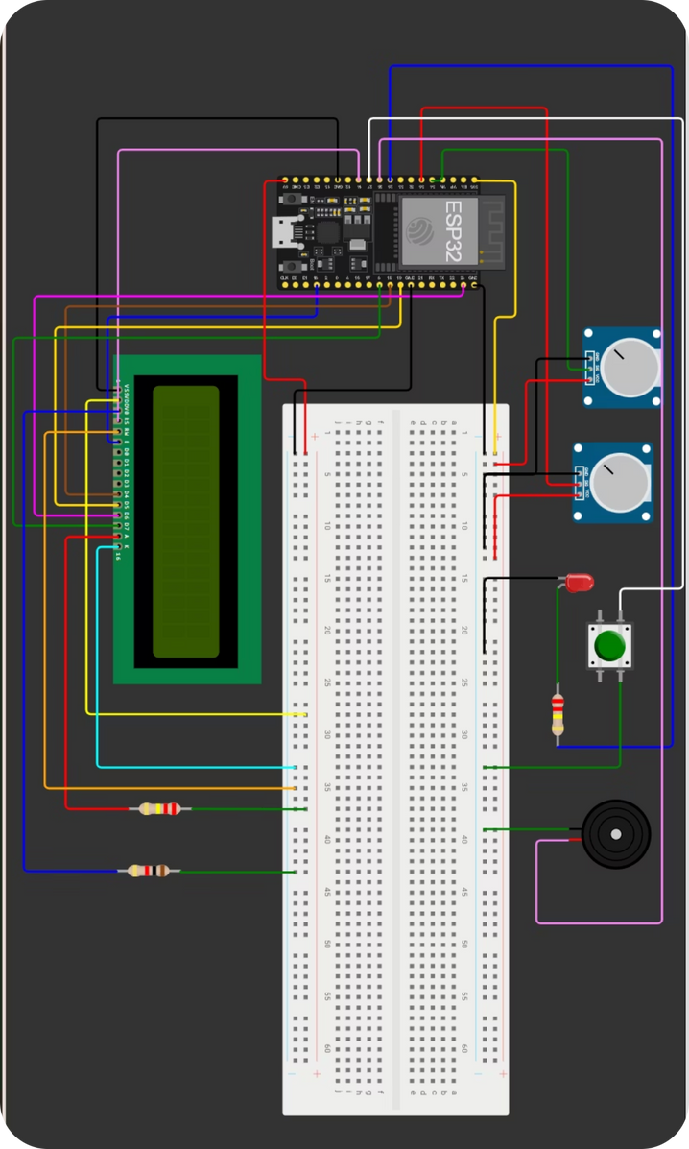

System Blueprint
This circuit diagram illustrates the interconnectedness of all hardware components, showcasing how the ESP32 orchestrates data flow from sensors to the display and cloud, forming the backbone of our smart energy monitoring system.
Notes:
4

Slide 5
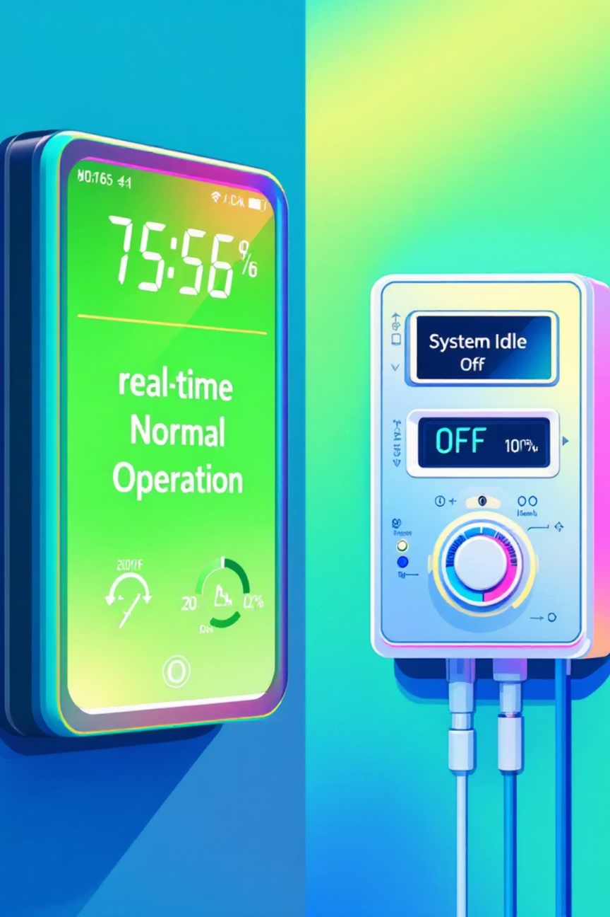
System Working: Normal and Power-Off Conditions
Normal Operation
Under normal conditions, CT sensors continuously measure current in both supply and load lines, while a voltage sensor tracks line voltage. The ESP32 processes this data to calculate energy usage and displays it on the LCD. When supply and load readings are balanced, the system confirms a "Normal / Safe Condition," keeping alerts inactive.
Power Off / Idle Condition
If the power supply is interrupted, all sensor readings will drop to zero. The LCD will clearly indicate "No Supply / System Idle." The ESP32 intelligently enters a standby mode, conserving energy until power is restored, at which point it automatically resumes full monitoring operations.
Notes:
5

Slide 6




Theft Detection Scenarios and System Response
Direct Bypass Theft
Reverse Connection
When a load is connected directly to the main supply, bypassing the meter, CT1 (supply) current drops while CT2 (load) shows high current. Our system instantly detects this discrepancy, triggering an alert.
If incoming and outgoing power lines are swapped, the system identifies a negative power flow direction. This unusual condition immediately triggers a theft alert, preventing energy pilferage.
Sudden Fluctuation
System Response
Any abrupt drop or spike in CT1 (supply) current indicates potential tampering or a line fault. The system interprets this as a suspicious event, prompting an immediate response.
Upon detecting any of these scenarios, the system activates the buzzer and LED. The LCD prominently displays "THEFT DETECTED," and an instant Wi-Fi alert is dispatched to the cloud or utility dashboard.
Notes:
6

Slide 7
Fluctuation and Billing Management
01
02
03
Fluctuation Monitoring
Timed Fluctuation Tracking
Attention Event Trigger
Fluctuations are registered when the absolute difference between load and supply current exceeds 0.2A. Each such event is counted once per occurrence.
Fluctuations are tracked within every 1-minute cycle. The count resets automatically after each minute to ensure timely detection of sustained issues.
Should the fluctuation count surpass 10 within a single minute, an "Attention" event is triggered, signaling a potentially critical issue or persistent tampering.
04
05
Dynamic Unit Calculation
Automated Billing & Alerts
Load current is continuously measured to calculate instantaneous power usage (Power = Voltage × Load Current). Energy Units (kWh) are then derived from Power (kW) × Time (hours).
The unit counter updates in real time, and the bill is calculated as Units × Tariff Rate. Both units and bill are updated on the dashboard, helping identify abnormal consumption patterns.
Notes:
7

Slide 8
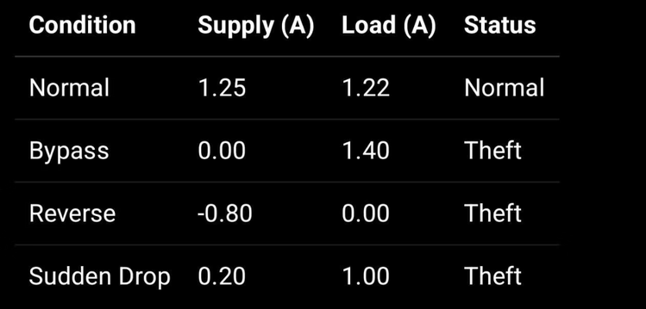
Results & Observations: System in Action
Readings Example (Simulation Output)
Normal Condition
Supply current closely matches load current, indicating efficient and legitimate energy flow.
The LCD proudly displays "Normal" status, providing reassurance of system integrity.
The LED and Buzzer remain OFF, signifying no detected anomalies or theft attempts.
All readings remain stable on both the serial monitor and the LCD, ensuring reliable operation.
The simulation output vividly demonstrates the system's ability to differentiate between normal operation and theft conditions, providing crucial data for rapid intervention.
Theft / Fault Condition
Detected when Load Current exceeds Supply Current, or in cases of reverse flow, bypass, or sudden drops.
The LCD immediately switches to "THEFT DETECTED," providing clear and urgent notification.
The LED and Buzzer instantly activate, drawing attention to the critical issue.
The system boasts a real-time response, reacting to anomalies in less than 2 seconds.
Notes:
8

Slide 9
Advantages & Limitations of Our Smart Energy Monitor
Key Advantages
Real-Time Monitoring: Offers immediate detection of irregular power usage, minimizing losses.
Cost-Effective Solution: Utilizes affordable CT and voltage sensors, coupled with the ESP32, making it an economical choice.
User-Friendly Display: An intuitive LCD provides live updates on supply, load, and theft status at a glance.
IoT-Enabled: Capable of sending critical alerts via Wi-Fi or cloud platforms like Blynk, ensuring remote oversight.
Scalable Design: Its flexible architecture allows for easy adaptation from single-home use to a comprehensive grid monitoring system.
Prevents Energy Theft: A powerful tool for electricity boards to significantly reduce financial losses due to theft.
Current Limitations
AC Loads Only: The system is currently optimized for accurate performance solely with alternating current (AC) loads.
Low Current Noise: CT sensors may exhibit minor noise and reduced accuracy at very low current levels.
Calibration Dependent: Requires precise calibration to ensure the accuracy and reliability of all readings.
Single-Phase Prototype: The current prototype operates on a single-phase system and is not yet developed for three-phase applications.
Network Reliance: The effectiveness of Wi-Fi alerts is contingent upon stable and continuous network connectivity.
Notes:
9

